Slide 1
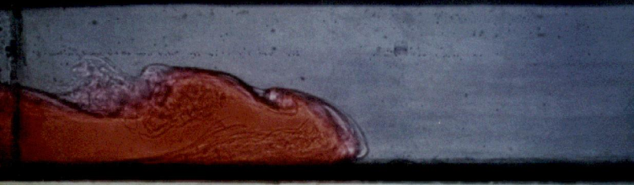
Quantifying numerical diffusion and dispersion in D-Flow Flexible Mesh using a lock-exchange experiment
Daan Koetsenruijter
ir. L.M. Keyzer, TU Delft, first supervisor
Prof. dr. J. Pietrzak, TU Delft, second supervisor

Slide 2
Content
1. Introduction
2. Approach
Reference
Sensitivity analysis
Quantification of errors
3. Results
Courant Max.
Time step size (Δt)
Resolution x-direction (Δx)
Resolution z-direction (Δz)
4. Conclusion
5. Discussion
Notes:
What? D-Flow Flexible Mesh – used to numerically model shallow water equations in curvilinear (complex shaped) grids
Why? Drinking water systems, large coastal systems, river dynamics
How? Shallow water equations to model advection-diffusion problem, length-scale is much larger than vertical scale thus hydrostatic
Problem: Numerical diffusion and dispersion as a result of higher-order non-linear terms – salinity or velocity gradients in the vertical (turbulence).
Numerical diffusion: viscosity because it overdamps the approximation – adds inertia –
Numerical dispersion: overcompensates to account for discontinuities or steep gradients

Slide 3
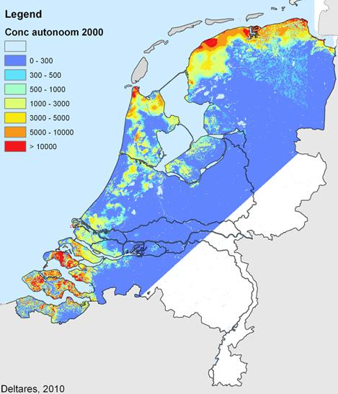
1. Introduction
Water infrastructure
D-Flow Flexible Mesh
Numerical diffusion and -dispersion
Lock-exchange experiment
Depth of the brackish-saline groundwater interface, CI concentration = 1000 mg/l. Source: Friocourt et al. [2014
Notes:
Why? Drinking water systems, large coastal systems, river dynamics – salt intrusion
What? D-Flow Flexible Mesh – used to numerically model shallow water equations in curvilinear (complex shaped) grids
How? Shallow water equations to model advection-diffusion problem, length-scale is much larger than vertical scale thus hydrostatic

Slide 4
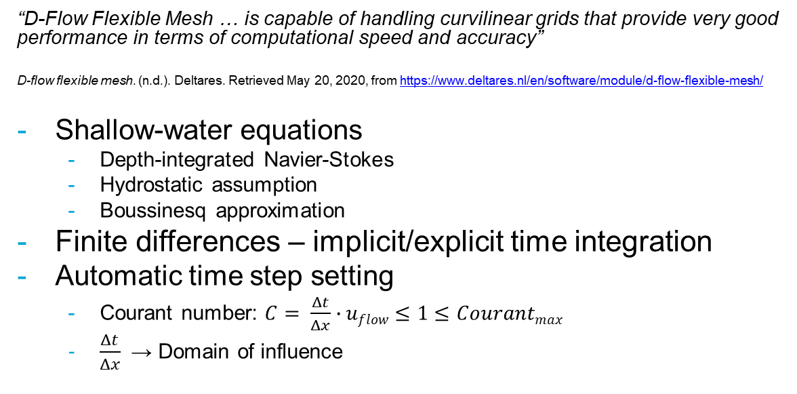
D-Flow Flexible Mesh
“D-Flow Flexible Mesh … is capable of handling curvilinear grids that provide very good performance in terms of computational speed and accuracy”
D-flow flexible mesh. (n.d.). Deltares. Retrieved May 20, 2020, from https://www.deltares.nl/en/software/module/d-flow-flexible-mesh/
Shallow-water equations
Depth-integrated Navier-Stokes
Hydrostatic assumption
Boussinesq approximation
Finite differences – implicit/explicit time integration
Automatic time step setting
Courant number: $C= \frac{Δt}{Δx}∙uflow≤1≤Courantmax$
$\frac{Δt}{Δx}$ → Domain of influence
Notes:
- Vertical velocity gradients
- Finite differences, explicit time integration – artificial damping for stability - Flux limiter – monotonicity – d-flowfm
- Domain of influence, what influences the value of salinity at a cell – in terms of space and time
Vertical flow velocities are only accounted for in the continuity equation, not through velocity gradients in the advection-diffusion equation
Density gradients are only accounted for in the pressure term. I.e. the difference in inertia is negligible but the difference in volumetric weight (affected by gravity) is accounted for.
For numerical methods that apply finite-differences in combination with an explicit time integration scheme often artificial damping is introduced to keep the scheme stable Zijlema [2015, Chapter 3].
Such damping is called a flux limiter and ensures monotonicity, an example of which is the monotone central limiter introduced
by Van Leer [1977]. This flux limiter is implemented by D-Flow FM and used for modelling the salinity
transport in this study.

Slide 5
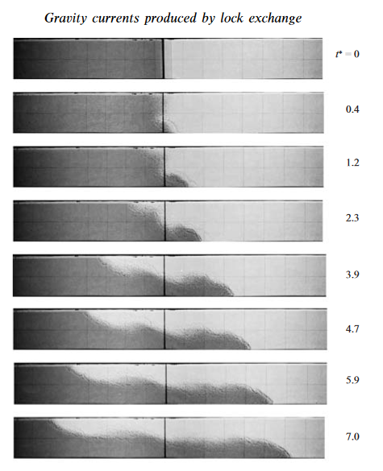
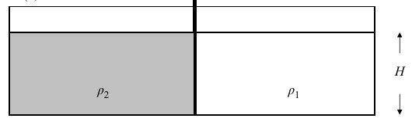
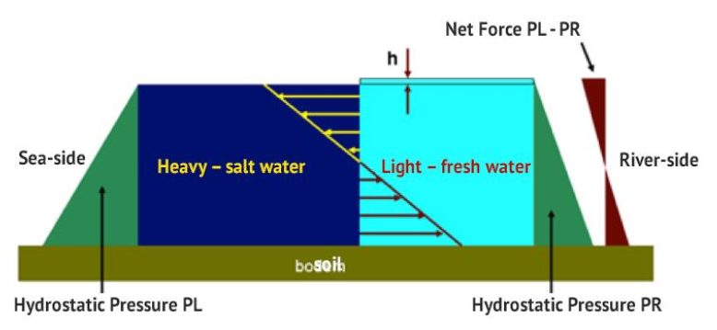
Lock-exchange experiment
10 m
10 km
Top: Basic lock-exchange setup - source: Shin et al. [2004]
Example of a lock-exchange experiment depicting two current
fronts flow opposite directions over time - Source Shin et al. [2004]
Bottom: Physical model of a density driven current - Source: Friocourt et al. [2014]
Notes:
In this research the density difference is caused by a salinity difference.
At the start of the experiment (t=0) these fluids set in motion and from two wave fronts,
a negative and a positive as a result of the gravitational and buoyant forces.
For the lock-exchange experiment the following configurations are set; the initial conditions define
a salinity difference of 10 ppt, ranging from 15 to 25 ppt over a single cell in the horizontal (i.e. Δx),
at x = 5000. The boundary conditions set a zero-discharge condition and are free slip, except for the
bottom of the domain which induces a Manning’s type friction. The domain is defined to be 100 meters
wide, 10 kilometers long, has a depth of 10 meters and every simulation spans a period of 5 hours. The
geometry is discretized by a computational grid with 100 cells of of 100 meters, 3 cells of 100 meters
and 10 cells of 1 meter in x-, y- and z-direction.
In order to perform the sensitivity analysis a number of simulations have to be performed. Four
sets of parameter ranges are simulated. First, for a range of values of the Courant
parameter are
simulated, then the same is done for Δt, Δx and Δz is done. For the latter two the reference model
is further developed, in which a constant time step size (Δx) and a constant spatial resolution in the
x-direction (Δt) is set.
Depending on the velocity variations seen near the mixing zone the hydrostatic assumption is valid, this
often means the solution should be smoothly varying.
For this reason near the negative and positive wave fronts (see 3.2) and near the interface between the two density driven currents numerical errors
may be expected due to respectively steep salinity gradients causing large discontinuities and high
shear stresses causing turbulence thus vertical velocity gradient.
Because the continuity
equation can only account for small variations in the vertical velocity gradient when larger accelerations
occur numerical models show physically unrealistic phenomena such as water level elevations and
density differences at unsuspected locations.
The numerical errors produced during such an experiment have often been investigated and this
research aims to use the results obtained from this experiment as a measure for the order of accuracy
of the D-Flow FM numerical flow model.

Slide 6
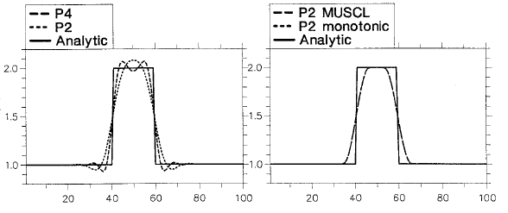
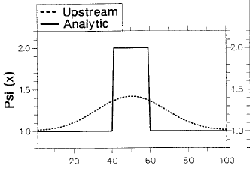
Numerical diffusion and -dispersion
Modelling large discontinuities with continuous approximations
Typical examples of numerical dispersion (left) and diffusion (right) - source: Pietrzak. [1998]
Notes:
Diffusion – damped solution
Dispersion – unrealistic extremes
Limiter – avoid oscillations through flux limiting, ensuring monotonicity, with high resolution TVD
Avoiding numerical diffusion and -dispersion requires contrasting measures, thus their response to certain modelling parameters is desirable.
Flow errors vs. numerical errors
depending on the velocity variations seen near the mixing zone the hydrostatic assumption is valid, this
often means the solution should be smoothly varying. For this reason near the negative and positive
wave fronts (see 3.2) and near the interface between the two density driven currents numerical errors
may be expected due to respectively steep salinity gradients causing large discontinuities and high
shear stresses causing turbulence thus vertical velocity gradient.
Because the continuity
equation can only account for small variations in the vertical velocity gradient when larger accelerations
occur numerical models show physically unrealistic phenomena such as
impossible extremes or density differences at unsuspected locations
Lower speeds then the energy balance prescribes (experimentally adjusted)
Diffusion is expected because of the Boussinesq assumption which states that
The numerical errors produced during such an experiment have often been investigated and this
research aims to use the results obtained from this experiment as a measure for the order of accuracy
of the D-Flow FM numerical flow model.

Slide 7
2. Approach
Baseline reference model
Sensitivity analysis
Quantification of errors
Notes:
To support answers to the research questions with data and reasonable arguments and thus finally
obtain an indication or even quantification of the numerical dispersion and -diffusion produced by D-
Flow FM the following research method is presented.

Slide 8
Baseline reference model
The boundary conditions:
Q = 0
Free slip
Bottom friction of Manning’s type
Initial conditions [15, 25] ppt
Width = 100 meters
Cubic cells
t = [0, 5h]
Δt = [auto, 10s]
25 ppt
15 ppt
10 m
10 km
Notes:
Compare results and look for errors
Default values of D-Flow
Realistic results

Slide 9
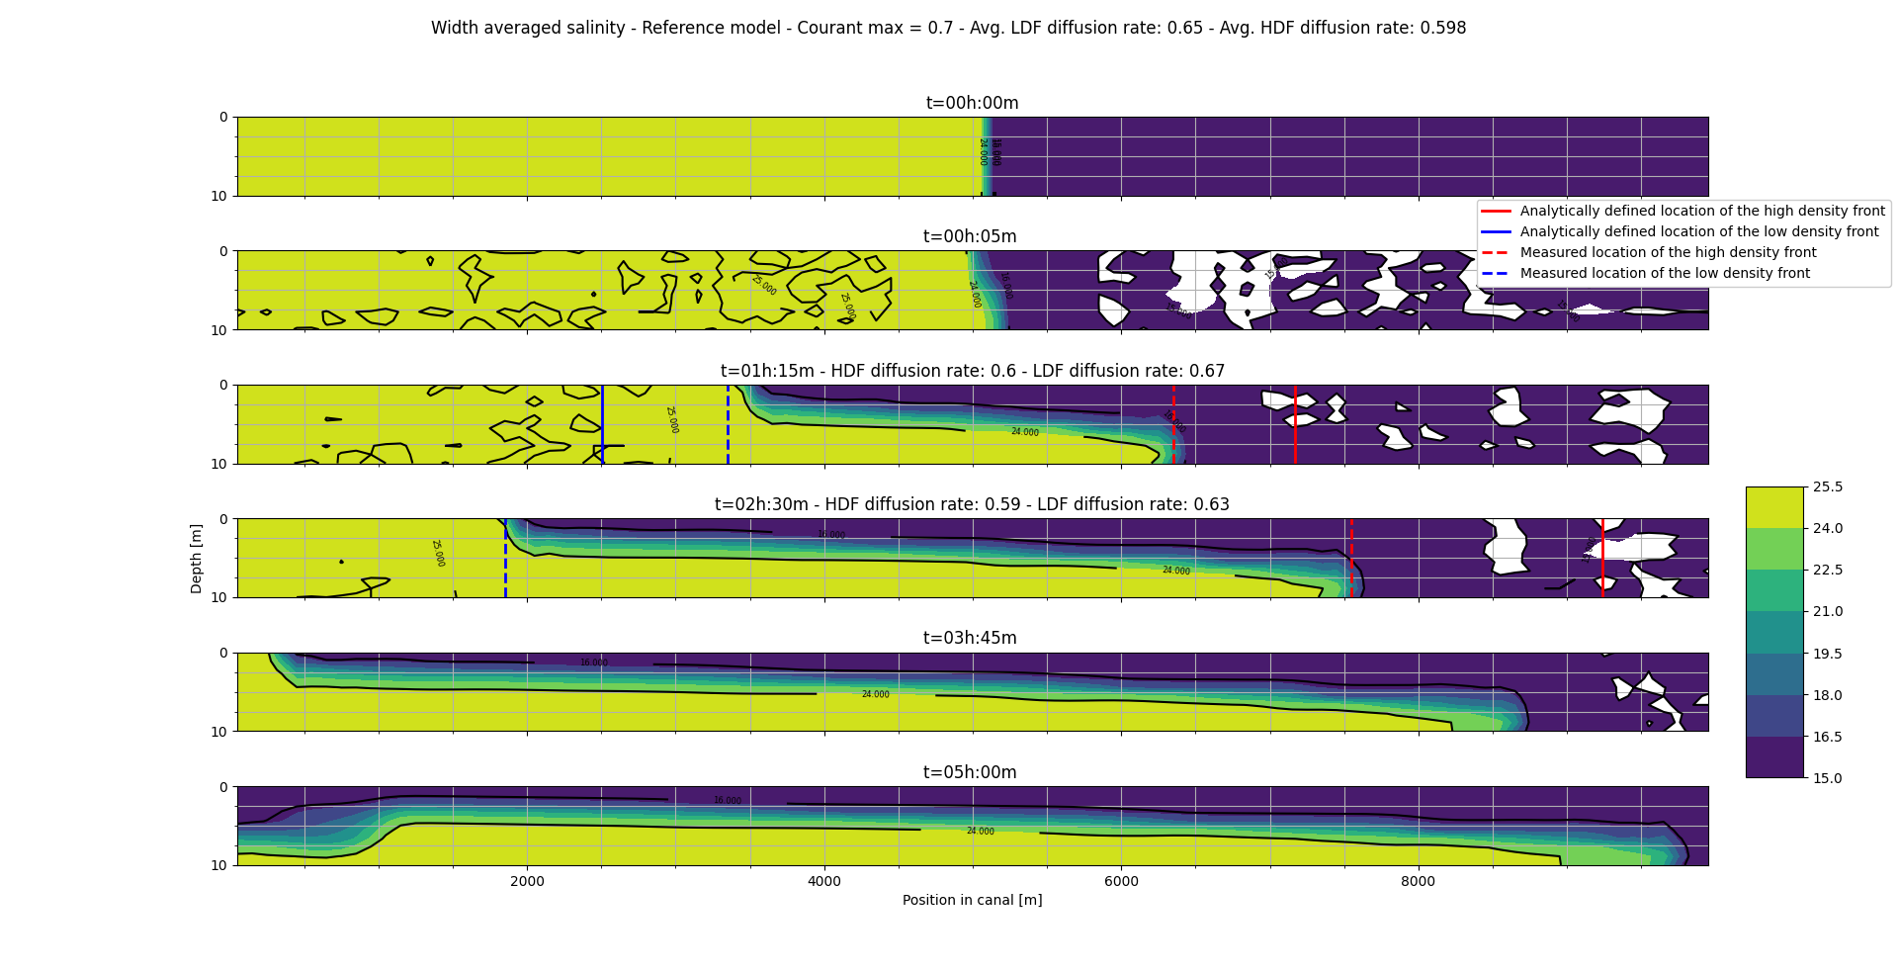
Reference
Notes:
Linear fps
Increasing mixing layer
Quite diffusive
Limiter at work

Slide 10
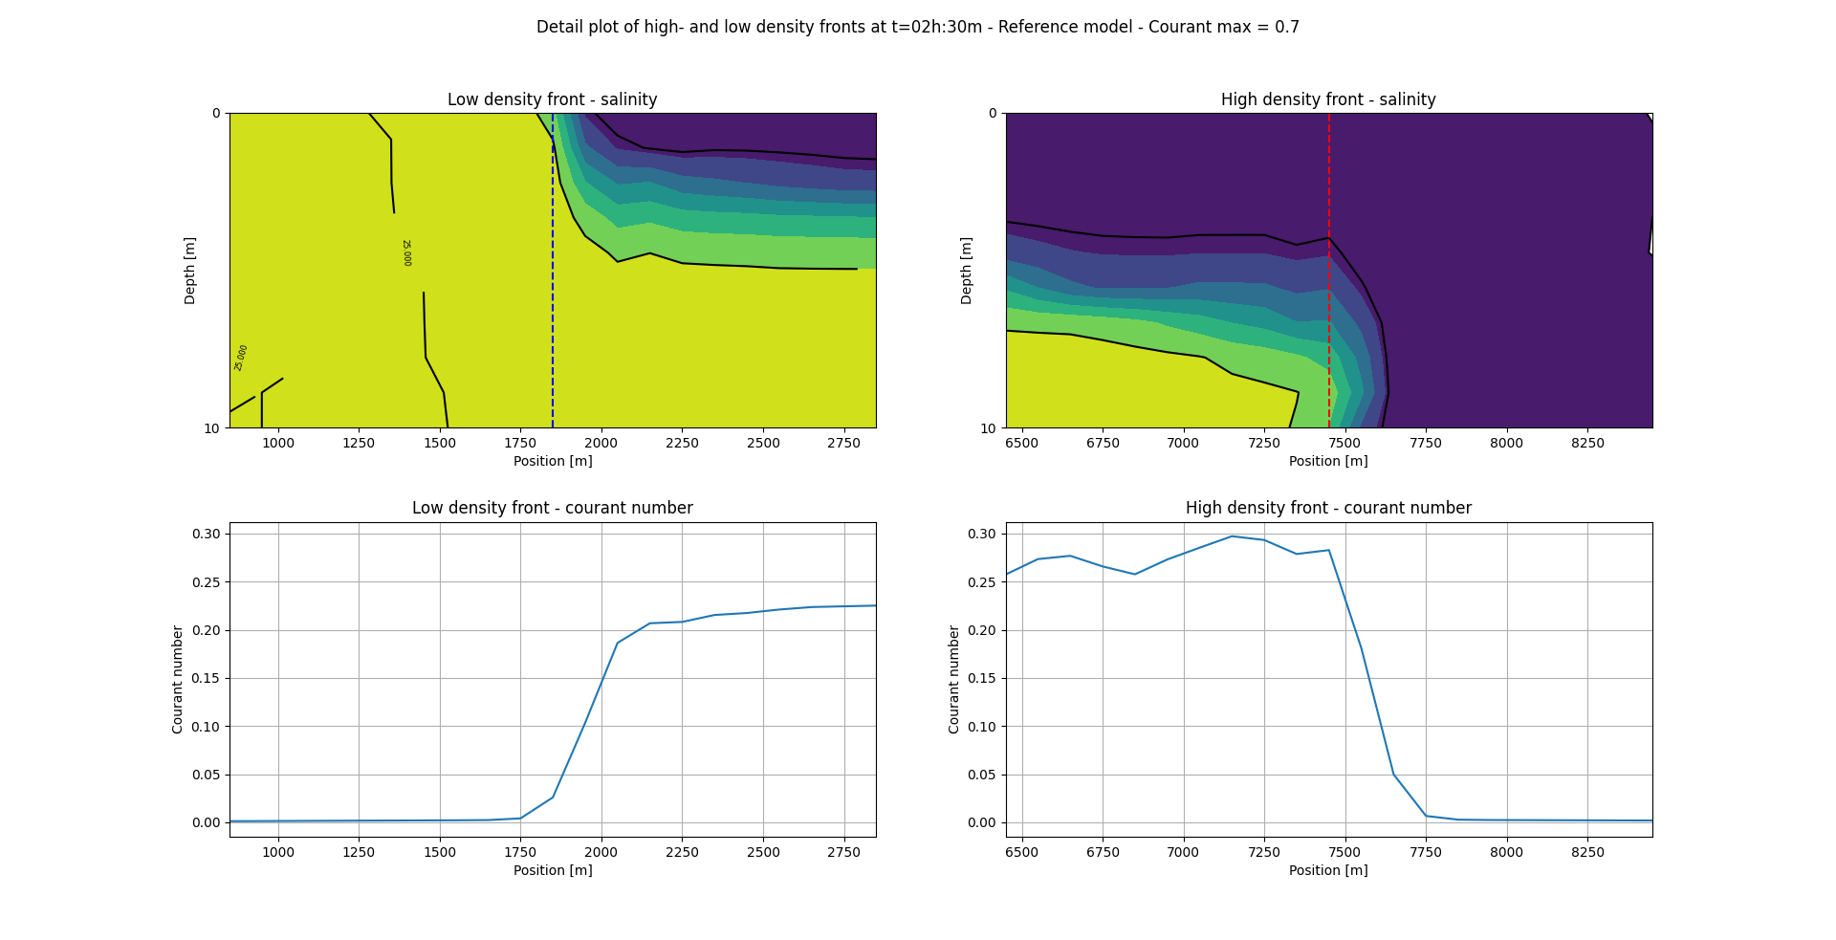
Reference
Notes:
Small oscillations at both fronts
Quite small Courant numbers

Slide 11
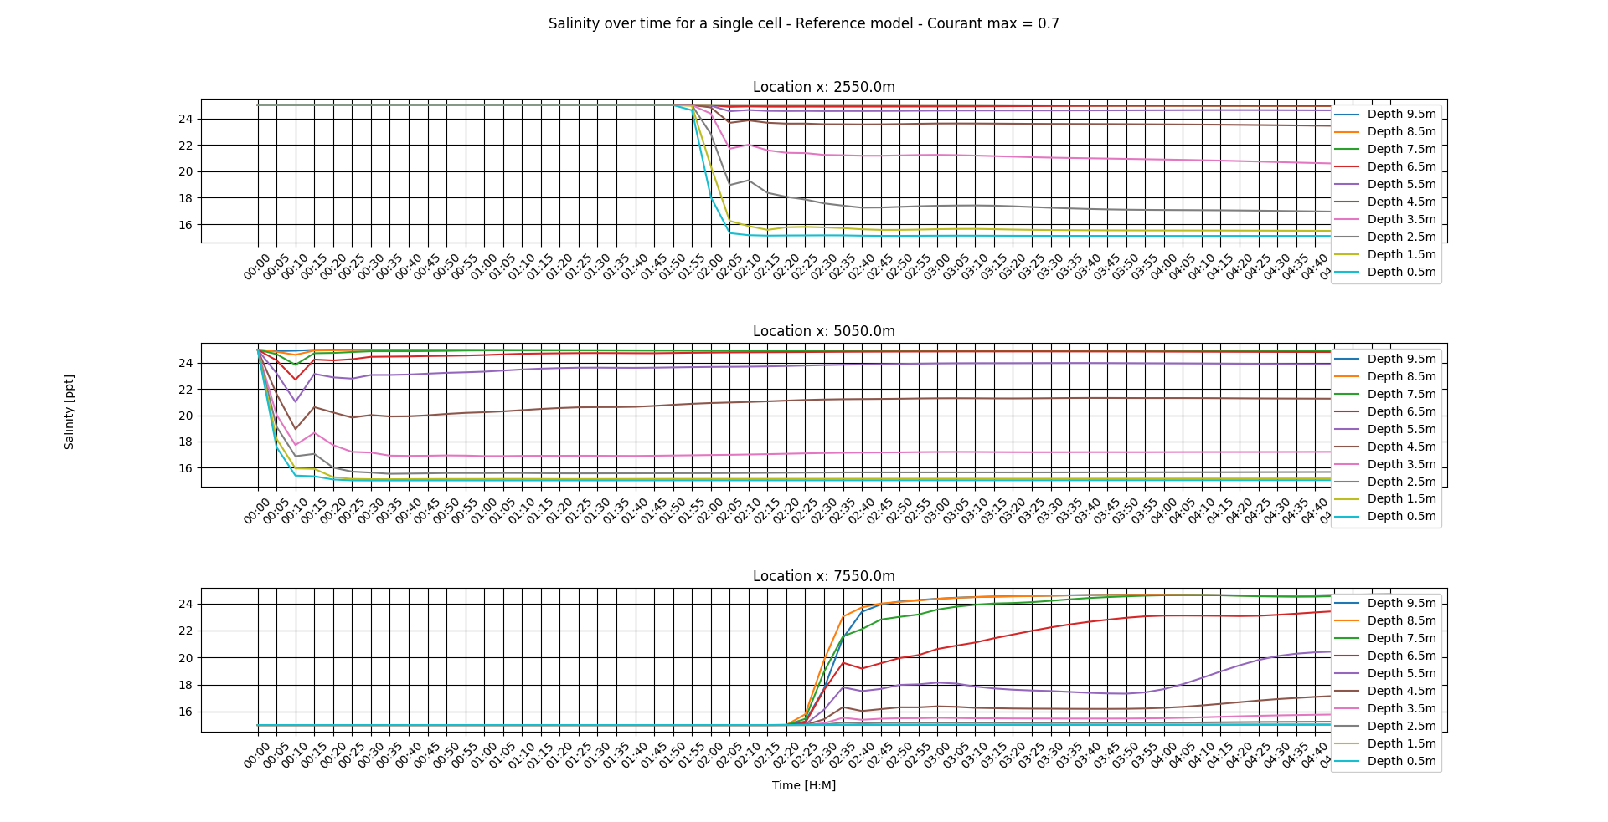
Reference
Notes:
- Salinity profile
Max oscillations at 2.5, 4.5 and 6.5 – x=2500, x=5000, x=7500

Slide 12
Sensitivity Analysis
Parameter variations:
Courant_{max} : [ 0.1 – 2.0 ] C: [ 0.1 – 2.0 ]
Δt : [ 0.1 – 1000 ] seconds C: [ 5E-4, 5 ]
Δx: [ 5 – 400 ] meter C: [ 1, 0.013 ]
Δz [ 0.22 – 2 ] meter C: [2.3, 0.25 ]
Output
Propagation speed of both density fronts
Extreme values
Relative salinity difference
Notes:
In order to perform the sensitivity analysis a number of simulations have to be performed. Four
sets of parameter ranges are simulated. First, for a range of values of the Courant
parameter are
simulated, then the same is done for Δt, Δx and Δz is done. For the latter two the reference model
is further developed, in which a constant time step size (Δx) and a constant spatial resolution in the
x-direction (Δt) is set.

Slide 13
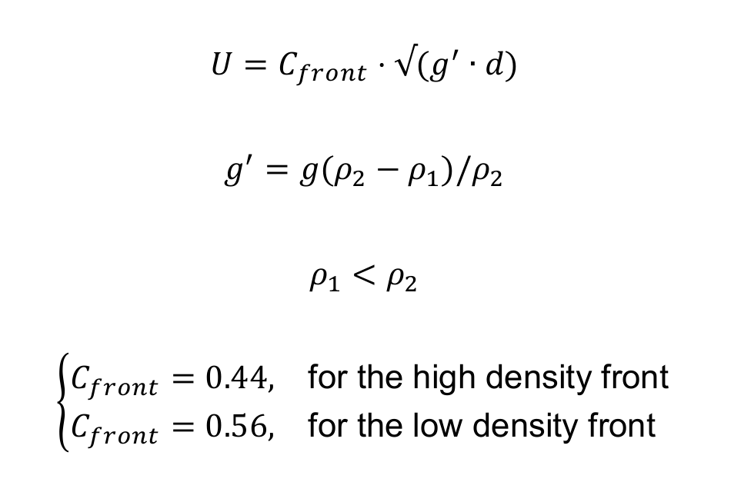
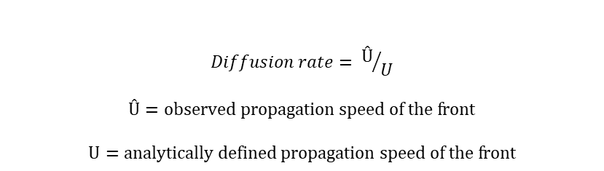
Quantification of Errors
Diffusion rates of the fronts
$$Diffusion rate= Û/U$$
$$Û=observed propagation speed of the front$$
$$U=analytically defined propagation speed of the front$$
Notes:
Numerical diffusion is quantified using the ratio between observed- and theoretical frontal
propagation speed of both fronts. Where the theoretical frontal propagation speed is estimated by
the following formulas, as used by Pietrzak [1998] and confirmed through experiment by Simpson and
Manga [1998], based on the energy conserving nature of gravity induced currents in long prismatic
channels.
The salinity at the before-
mentioned locations are then plotted and compared to the appropriate reference model from which a
salinity difference can be calculated. This salinity difference is thus relative to the respective reference
model and it’s normalized standard deviation serves as the measure the sensitivity of numerical errors
to the respective parameter.

Slide 14
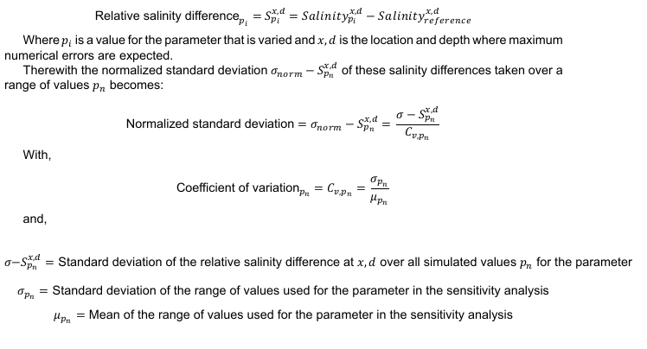
Quantification of Errors
Sensitivity of errors to a parameter
Notes:
Numerical diffusion is quantified using the ratio between observed- and theoretical frontal
propagation speed of both fronts. Where the theoretical frontal propagation speed is estimated by
the following formulas, as used by Pietrzak [1998] and confirmed through experiment by Simpson and
Manga [1998], based on the energy conserving nature of gravity induced currents in long prismatic
channels.
The salinity at the before-
mentioned locations are then plotted and compared to the appropriate reference model from which a
salinity difference can be calculated. This salinity difference is thus relative to the respective reference
model and it’s normalized standard deviation serves as the measure the sensitivity of numerical errors
to the respective parameter.

Slide 15
3. Results
Relative salinity differences
Courant_{max}
Δt
Δx
Δz
Mean & standard deviation
Normalized standard deviation
Limits of D-Flow FM
Notes:
In practice, this new analysis allows the numerical study of dispersion errors on all types of
mesh and for multiple dimensions. Nonetheless, when mesh uniformity and one-dimensionality assumptions
are imposed as in the classical method, the results of this new technique coincide with those of the classic
method.

Slide 16
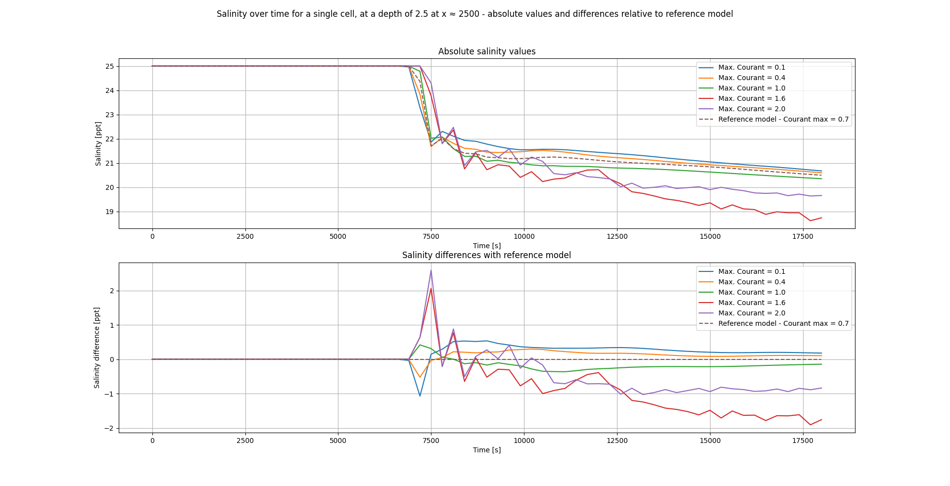
Courant_{max}
Notes:
The effect of the on the salinity differences, which are of quite large scale, can be observed.
Especially for numbers between 1.6 and 2.0 the effect of the parameter on errors in the salinity profile can be seen in the large oscillation after the front has passed.
As expected the model shows spurious oscillations for large values of Courant
, nonetheless this
only starts occurring at values higher than 1.6. At values between 1.0 and 1.6 and for values lower
than 0.1 only minor over- and undershoot can be observed. An abrupt oscillation at x = 5000m is
modelled at all variations of the Courant
parameter and can also be observed in the reference
mode. This is probably a result of the choppy spike on top of the front (see figure 3.2). The steep low
density front causes obvious spurious oscillations at a Courant
of 1.6 up to 2.0 with an amplitude
of approximately 1 ppt. At the low density front the errors observed are significantly larger, especially
at Courant
values of 1.6 to 2.0. Generally the absolute order of the errors is up to 2 ppt. for
Courant
values higher than 1.6 but remain below 0.5 ppt. for Courant
values lower than 0.7.
Until Courant
equals 0.1, then the model seems to become quite diffusive Δt, which causes the
front to arrive slightly later.

Slide 17
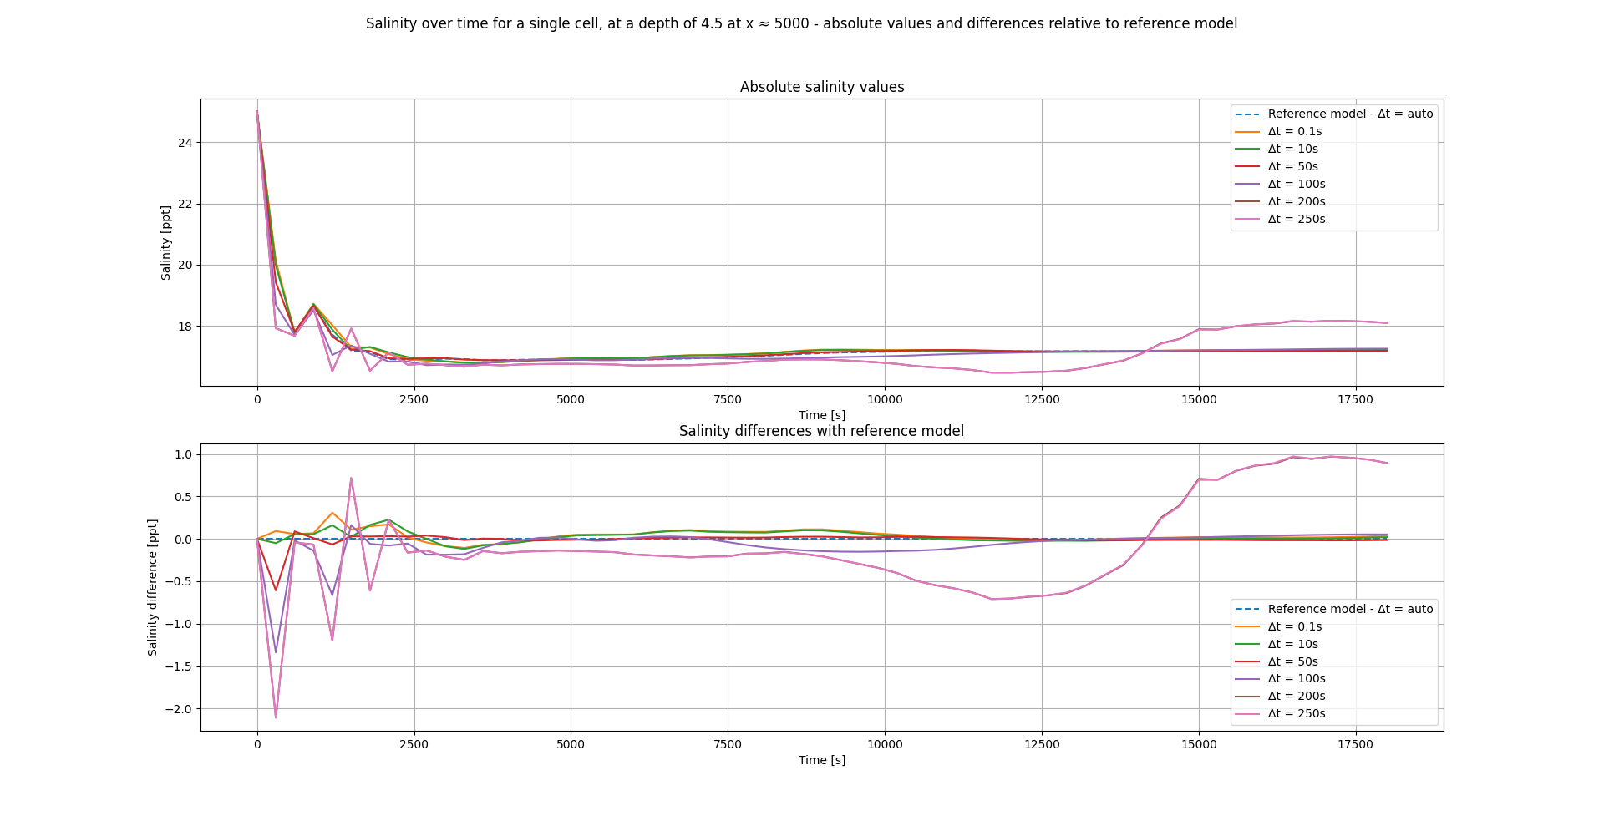
Δt
Notes:
Clear oscillations can be seen as
increases to 250 seconds of the same type and scale as in the variations of
which coincides with the expected
behaviour at large Courant numbers.
At larger values of the time step size (Δt ≥ 50s) clear oscillations start to develop as the front has
passed, up to an amplitude of approximately 1.5 ppt. For Δt ≤ 50s (giving an approximate Courant
number of 0.25, with Δx = 100 and a velocity of 0.5 m/s) the amplitude of these oscillations drops
below 0.5 ppt. The oscillations observed have an amplitude of approximately 2 ppt. at the location of
the initial disturbance and at the low density front. At the low density front the oscillations also continue
to exist for a longer period of time. The constant salinity difference for Δt ≤ 50s of approximately
0.5 ppt. can not be described as a numerical error due its smooth and constant form. However, the
observed differences can be explained by the fact that the reference model’s average time step size
equals 65 seconds, which is automatically determined and kept as large as possible as long as the
Courant number does not exceed the Courant
parameter. Therefore solutions with a smaller time
step size can be more accurate yet differ from the reference model accross the domain. Lastly the
same steep and choppy high density front can be seen to develop for an estimated Courant number
higher than 1.25 as was observed in the variations of Courant
.

Slide 18
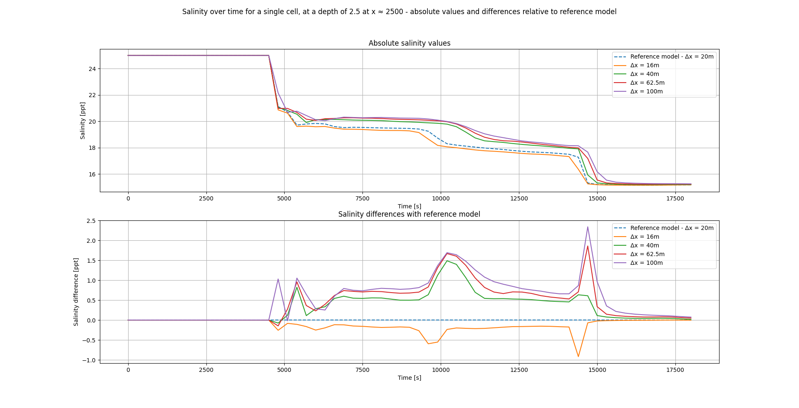
Δx
Notes:
Clear diffusion over time can be observed at larger values of delta x
At t = 15000 also the effects of the reflected wave can be observed in the final salinity drop.
A first observation is that the whole domain is less oscillatory probably due to the small time step size
that is configured (Δt = 10s). Increasing relative salinity differences are observed as Δx increases,
some of which caused by a diffusive error but is possibly also part due to an increasing error in place-
ment of the measurement location. Although the order of errors observed is of 2 ppt. this is not used
to quantify the global numerical diffusion of the model because of it’s time dependency and possible
measurement error. The fact that the model is mainly diffusive might be explained by the fact that the
time step size is chosen to be quite small (Δt = 10s) which, for larger Δx causes the Courant number to
decrease significantly. Since the domain of influence then becomes much larger than the discretized
domain the local approximation becomes overly damped. Lastly, a little over and undershoot can be
seen to develop for all values of Δx. But because the shape of the profile does not change this is
attributed to the backlog of the more diffused approximations.

Slide 19
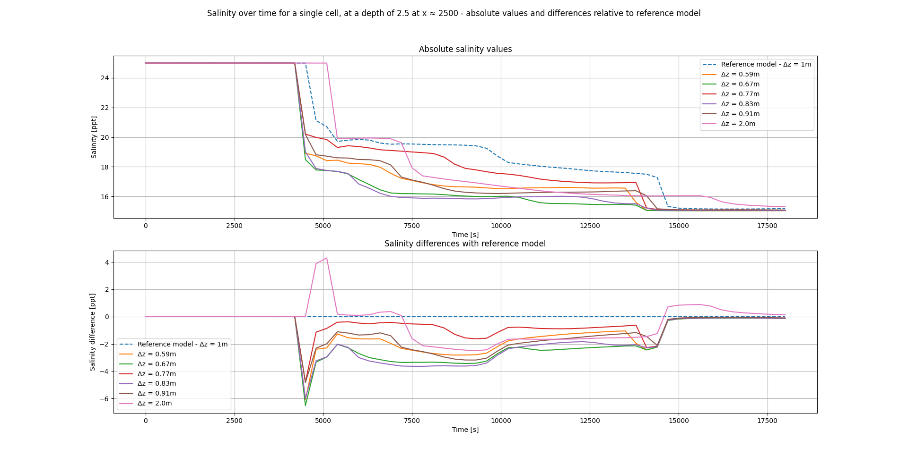
Δz
Notes:
A large diffusion of the frontal frontal propagation speed is visualized by the backlog of the front at delta z = 2m
Further most diffusion of the frontal propagation speed is minimized for delta z < 0.91 m.
Interestingly as delta z decreases the salinity profile does not change proportionally.
The numerical diffusion in the model decreases as Δz decreases which coincides with section 3.6. For
the high density front the same goes. This is also confirmed by the sensitivity analysis (see section
3.6). Although in this same section it becomes clear that for the current Δt and Δx the diffusive error
on a global scale is minimized, the variations of Δz show that locally salinity differences are extremely
sensitive to changes in Δz. These errors, which reach up to values of 8 ppt., are caused by the large
backlog of the front and indeed indicate, yet are not used to quantify, the (large) numerical diffusion.
The quantification of this kind of diffusion in section 3.6 (diffusion of the frontal propagation speed)
shows that the large backlog dissapears at Δz ≤ 0.91m.

Slide 20
Classification of errors
Global diffusion
Local diffusion
Over-/undershoot
Spurious oscillations
Notes:
In practice, this new analysis allows the numerical study of dispersion errors on all types of
mesh and for multiple dimensions. Nonetheless, when mesh uniformity and one-dimensionality assumptions
are imposed as in the classical method, the results of this new technique coincide with those of the classic
method.

Slide 21
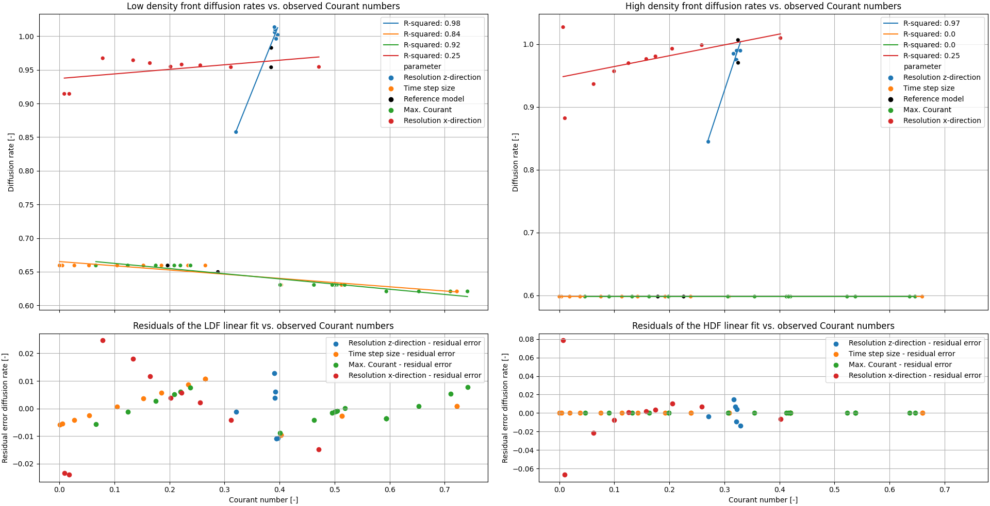
Diffusion rates
Notes:
First, the model’s sensitivity to global diffusion is analyzed by means of the diffusion rates of the frontal
propagation speed and their possible trends (see figure 3.8). These trends, attained through linear
regression of the diffusion rate data, show that no direct link between the Courant number and global
diffusion can be made. With the exception that if Δt and Δx are sufficiently small almost no diffusion
can be expected for reasonable Courant numbers (≥ ±0.05).
Nonetheless, it is clear that when the Δt and Δx are sufficiently small diffusion across the
domain can very effectively be minimized by decreasing Δz. Further research studying the variations
of Δz in the range 1.0-2.0 meter and at different Δt and Δx in this context would have to show for what
range of values of Δz, Δx and Δt such global diffusion can best be tackled.

Slide 22
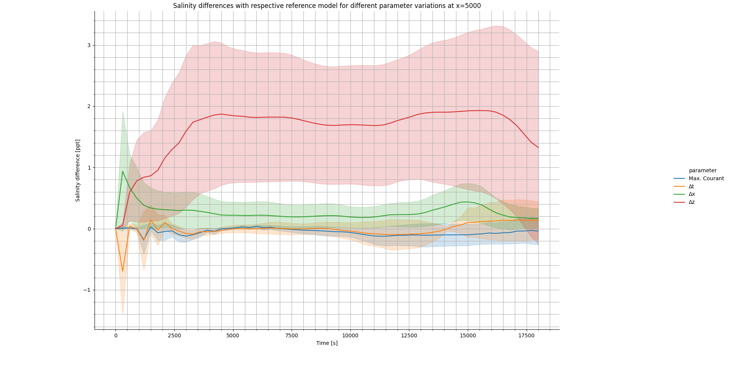
Relative salinity differences
Notes:
Mean and standard deviation of the relative salinity differences depicting the mean and the standard deviation through a fat line and slightly transparent area, respectively.
Especially the variation of delta z shows large influence on the approximation in terms of global diffusion.
Also delta x has quite an influence on global diffusion and shows a peak in the beginning because of probable measurement errors.
Finally spurious oscillations appear sensitive to temporal parameters delta t and Courant max.

Slide 23
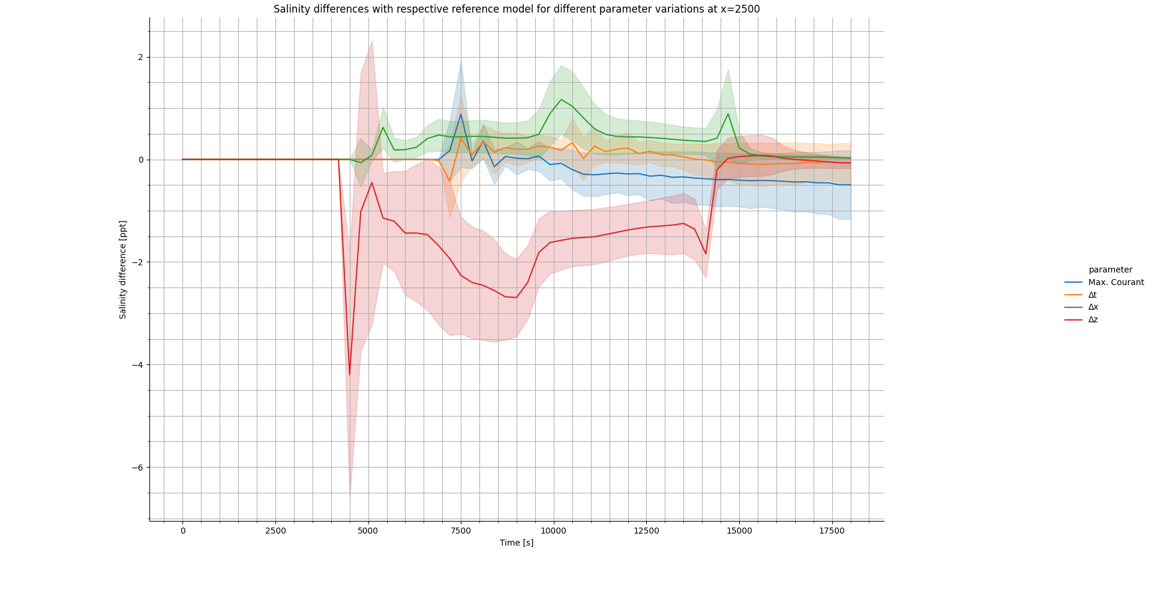
Relative salinity differences
Notes:
Relative differences depicting the mean and the standard deviation through a fat line and slightly transparent area, respectively.
Global diffusion at the low density front appears to be most sensitive to delta z
Oscillations as the front has passed appear to be sensitve to delta t and Courant max

Slide 24
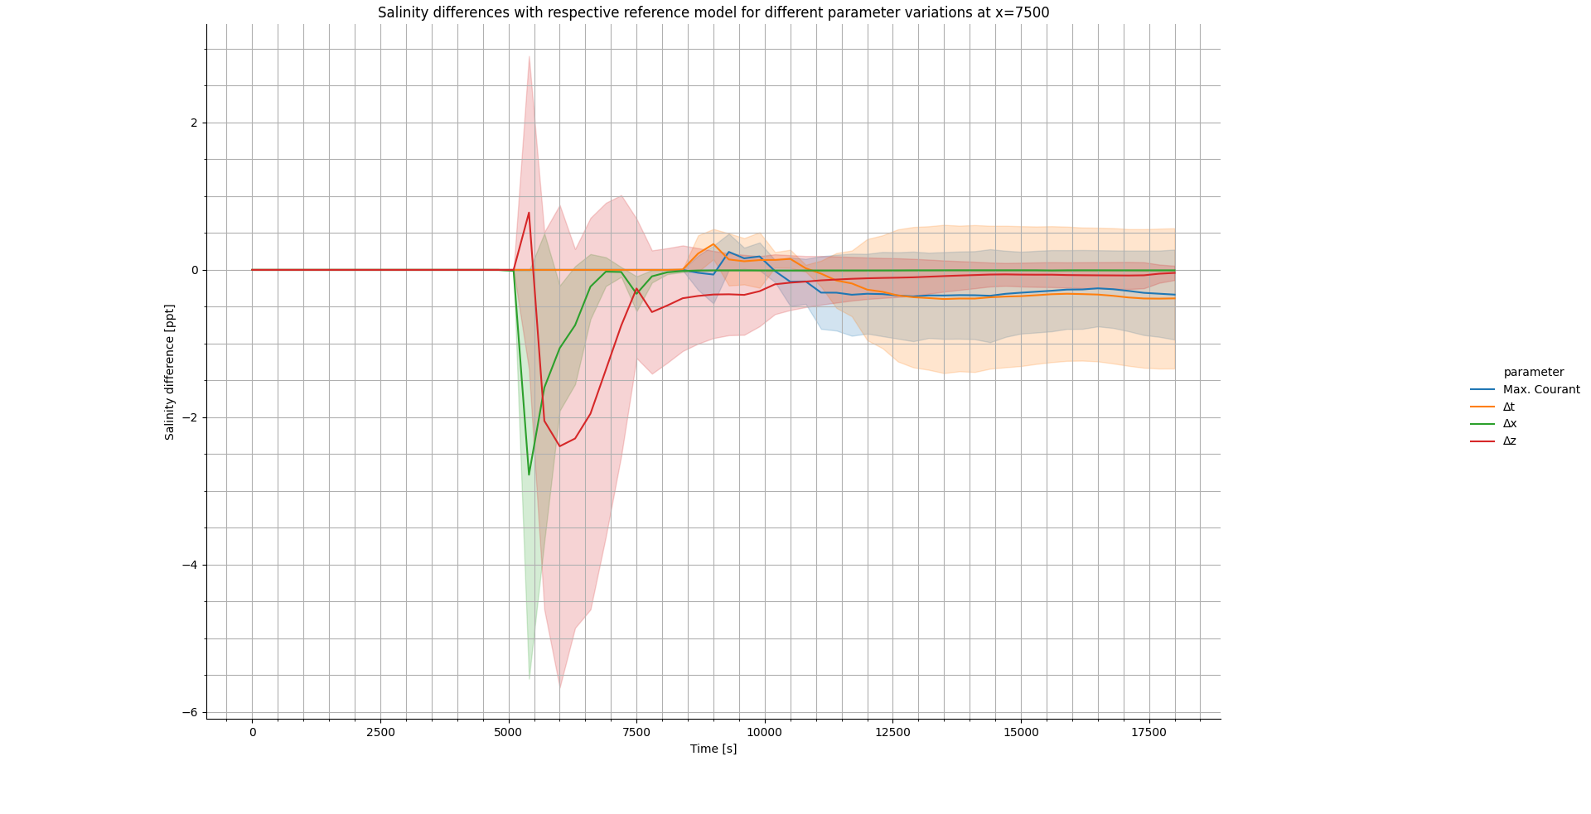
Relative salinity differences
Notes:
Both delta x and delta z are observed to have a large influence on the shape of the front, defined as local diffusion.
For these parameters global diffusion drastically decreases over time.
For delta t and Courant max minor over and undershoot can be observed and increased global diffusion over time is caused by large Courant number

Slide 25
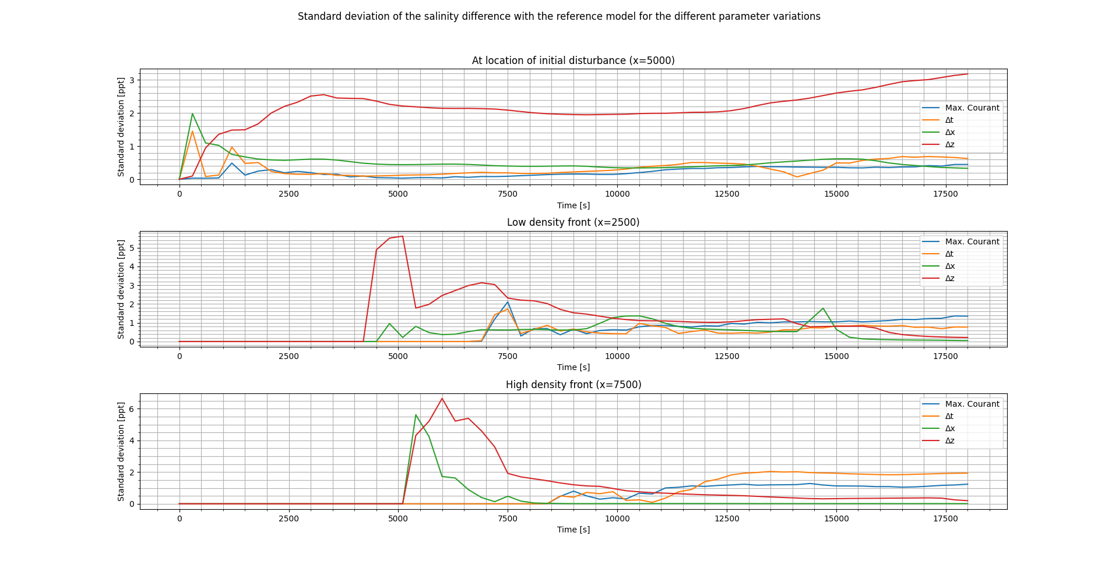
Normalized standard deviation
Notes:
Normalized standard deviation of the relative salinity differences.
In terms of global diffusion, delta z can influence salinity values up to 2 ppt.
Salinity values at the front are highly sensitive to delta x and delta z up to 5 ppt. as a result of local and global diffusion.
Both parameters delta t and Courant max have a significant influence on the dispersive oscillatory type of error.

Slide 26
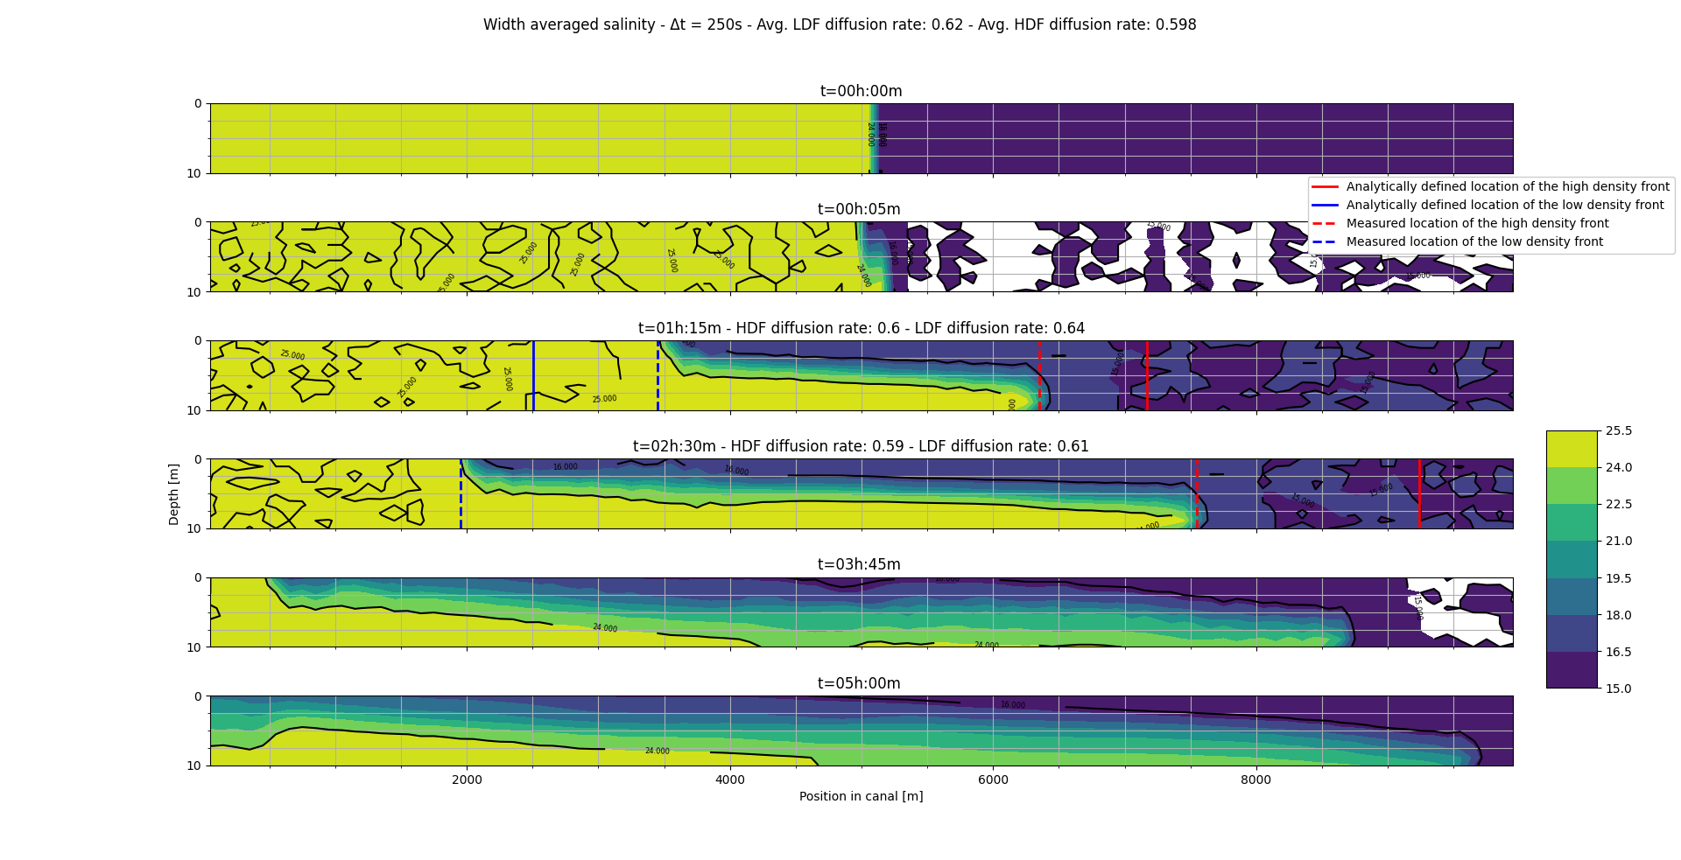
Limits of D-Flow FM
Notes:
The simulations where Δt was varied clearly showed the limits of the model for minimal and maximum Courant numbers.
Given Δx = 100m and an estimated average velocity of 0.5 m/s the model stopped producing reasonable results for Δt ≥ 300s which gives a Courant number of 1.5.
It almost did not show indications for a salinity transport flux limiter anymore for Δt ≤ 0.1s which gives a Courant number of 0.0005.

Slide 27
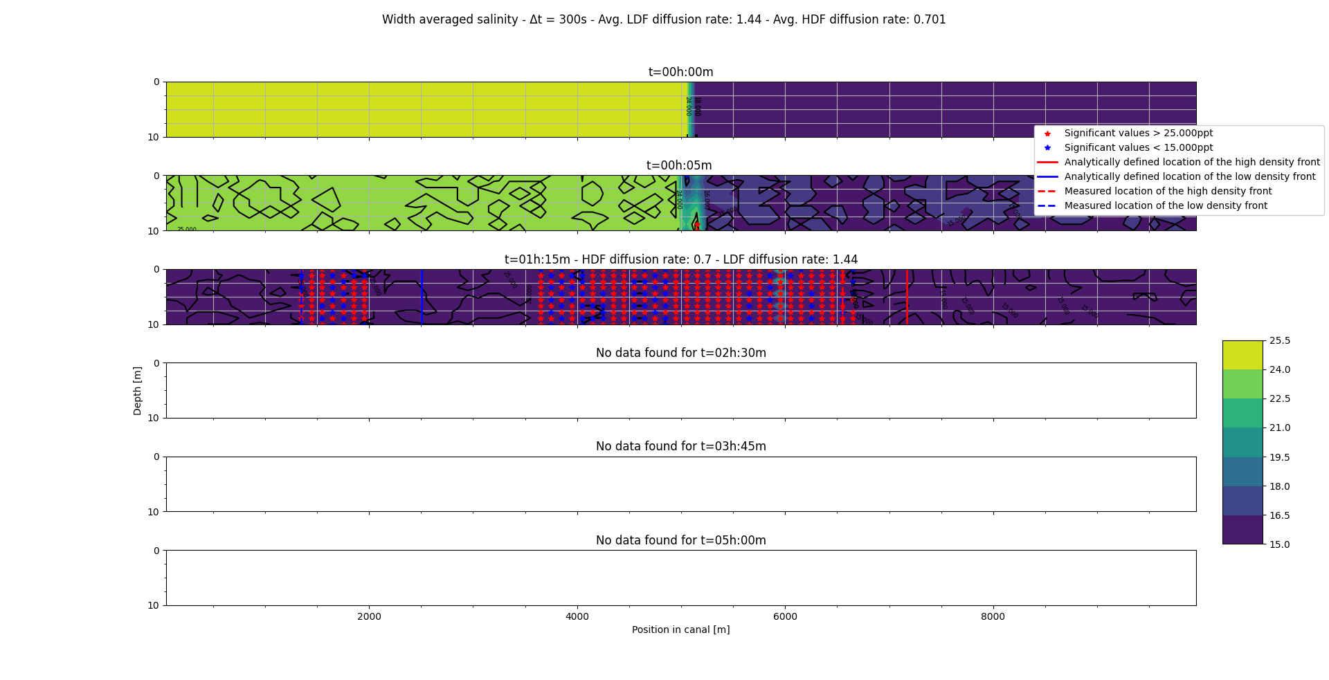
Limits of D-Flow FM
Notes:
The simulations where Δt was varied clearly showed the limits of the model for minimal and maximum Courant numbers.
Given Δx = 100m and an estimated average velocity of 0.5 m/s the model stopped producing reasonable results for Δt ≥ 300s which gives a Courant number of 1.5.
It almost did not show indications for a salinity transport flux limiter anymore for Δt ≤ 0.1s which gives a Courant number of 0.0005.

Slide 28
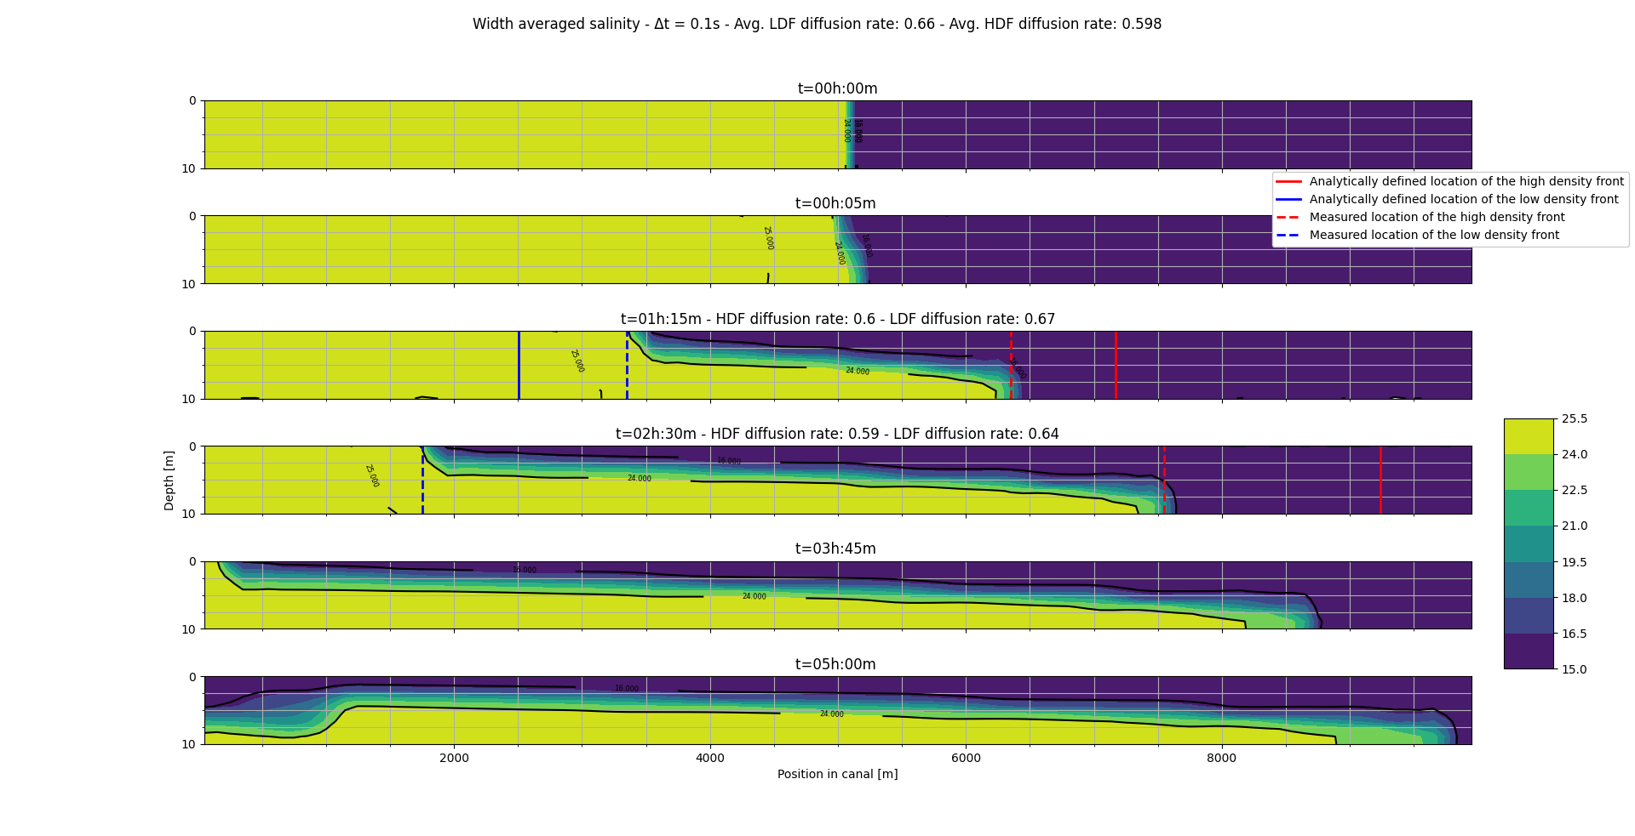
Limits of D-Flow FM
Notes:
The simulations where Δt was varied clearly showed the limits of the model for minimal and maximum Courant numbers.
Given Δx = 100m and an estimated average velocity of 0.5 m/s the model stopped producing reasonable results for Δt ≥ 300s which gives a Courant number of 1.5.
It almost did not show indications for a salinity transport flux limiter anymore for Δt ≤ 0.1s which gives a Courant number of 0.0005.
A simulation that shows almost no signs of being limited by
a flux limiter. Under the assumption that the contour lines of 15 and 25 ppt. away from the travelling
fronts that do not contain values significantly outside the physical limits of the salinity ([15, 25], which
would be indicated by red or blue dots) are indications of the approximation being limited by the flux
limiter. This coincides with the fact that as Δt decreases the time integration approaches the actual
integral. Therewith, because of the implicitness of D-Flow FM the model hardly has to be limited. This
could be tested by running a model with the same Δt but with a fully explicit time integration scheme
(i.e. setting θ = 0).

Slide 29
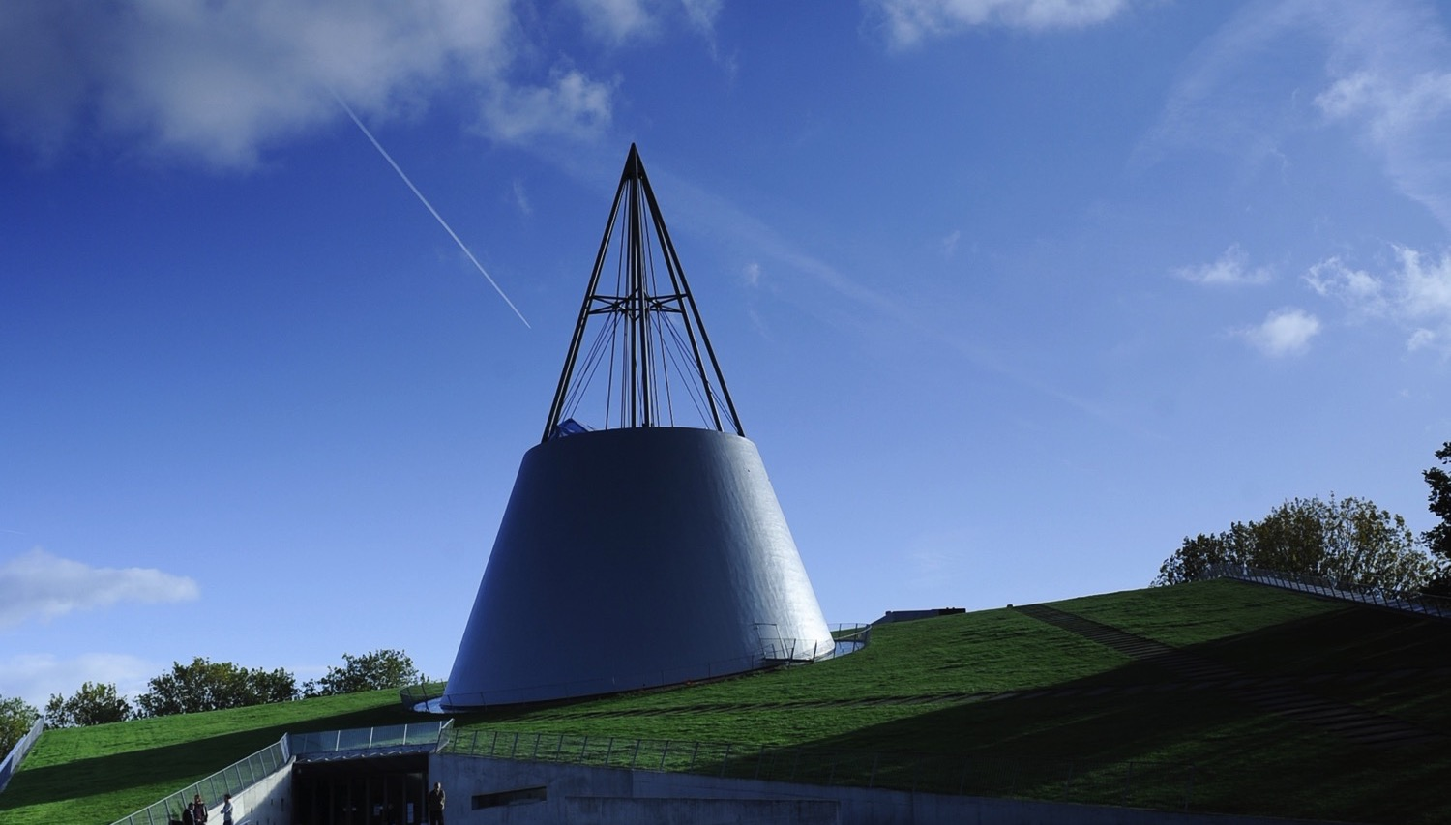
Conclusion: oscillations
When horizontal resolution is large (100m)
Courant_{max}
Over-/undershoot for values > 1.0 & < 0.1
Spurious oscillations for values > 1.6
Time step size (Δt)
Spurious oscillations for t ≥ 50s (Courant ≈ 0.25)
Notes:
The origin of the errors observed in the variations of Δx appear to be of a diffusive kind (figure 3.6),
which explains the fact that at smaller values of Δx the front arrives earlier. The fact that the model
is mainly diffusive might be explained by the fact that the time step size is chosen to be quite small
(Δt = 10s) which, for larger Δx causes the Courant number to decrease significantly. Since the domain
of influence then becomes much larger than the modelled gradient the approximation is overly damped.

Slide 30
Conclusion: sensitivity
Global diffusion is mostly influenced by Δz up to 2 ppt.
Local diffusion is sensitive to Δz and Δx and can change salinity values up to 5 ppt. at the fronts
Oscillations in the middle of the domain are mostly influenced by Δt up to values of 1 ppt.
Courant_{max} mostly influences oscillations at the low density front up to values of 2 ppt.
Notes:
In figure 3.12 the sensitivity of the model’s accuracy to the different parameters are quantified.
Global diffusion are most sensitive to Δz and generally have a range of influence of 2 ppt. Local
diffusion is mostly sensitive to Δz and Δx and can change salinity values up to 5 ppt. at the fronts.
Over-/undershoot is most sensitive to the Courant parameter but occurs very little and only up to
1 ppt.
Finally, as established, both parameters Δt and Courant have a significant influence on the dispersive oscillatory type of error.
Although the origin of these oscillations could not solely be dedicated to numerical dispersion, they are nonetheless quantified as follows;
for the middle of the domain spurious oscillations are sensitive to Δt up to a value of 1 ppt.
For the low density front both Δt and Courant can influence salinity values up to 2 ppt.

Slide 31
Conclusion: recommendations
Set the limiting resolution first (Δx or Δt)
Increase the other resolution until results can be compared to a model with automatic time step setting
Lastly reduce diffusivity by decreasing (Δz)
If the shape of the front is important decreasing Δx or Δz is likely to be most effective
If oscillations are observed decreasing Δt or Courant_{max} is likely to be most effective.
Notes:
This
makes sense since oscillations, which are a sign of instability, are typical for explicit schemes which
is why they require artificial damping [Zijlema, 2015]. This could be confirmed by varying the θ (the
implicitness parameter) and look at the effects of different Δt.
Nonetheless, it is clear that when the Δt and Δx are sufficiently small diffusion across the
domain can very effectively be minimized by decreasing Δz. Further research studying the variations
of Δz in the range 1.0-2.0 meter and at different Δt and Δx in this context would have to show for what
range of values of Δz, Δx and Δt such global diffusion can best be tackled.
Limits of D-Flow FM show clearly for estimated Courant numbers between 0.7 and 1.5 in the horizontal.
The limits of the Δz become visible for Δz ≤ 0.5m which corresponds with a Courant number of 2.0,
given Δt = 10s and an estimated vertical velocity of 0.1 m/s
Based on these results it is recommended to start modelling with either a varying Δx or Δt, de-
pending on which is considered limiting (start with the limiting parameter). Increase the resolution of
the parameter until the results show similar diffusion as in a model using an automatic time step set-
ting with Courant
= 0.7. Hereafter possibly reduce the diffusivity of the model by increasing the
resolution in z-direction until computation times become unacceptable. Additionally it is assumed that
all observed oscillations in models that could reasonable be considered were not significant or could
not clearly be classified as numerical errors. Some of the discussion that brought this uncertainty is
presented below.

Slide 32
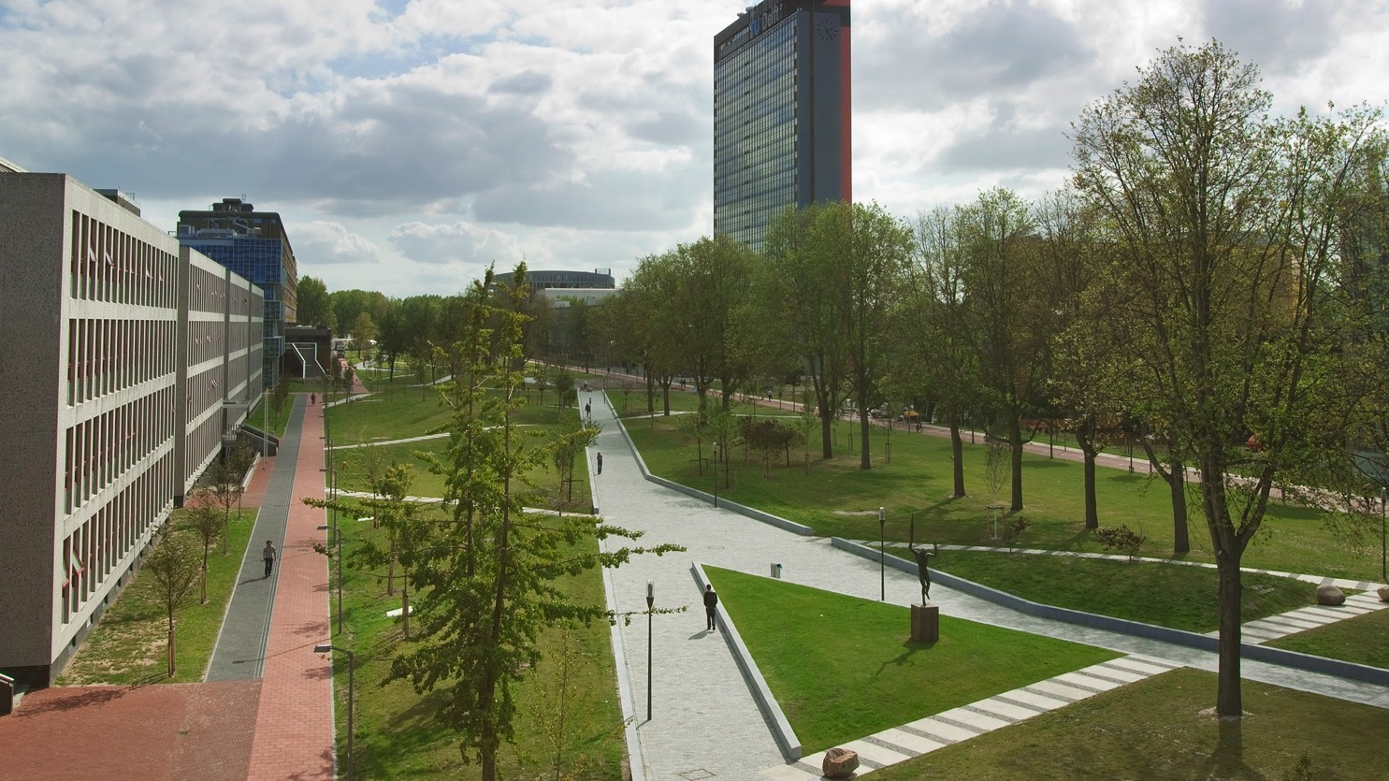
Discussion
It is unknown to what extent flow errors were amplified
Oscillations could be an effort of D-Flow to model internal waves
Measurement errors, especially present in the spatial variations, have not been quantified

